Slide 1
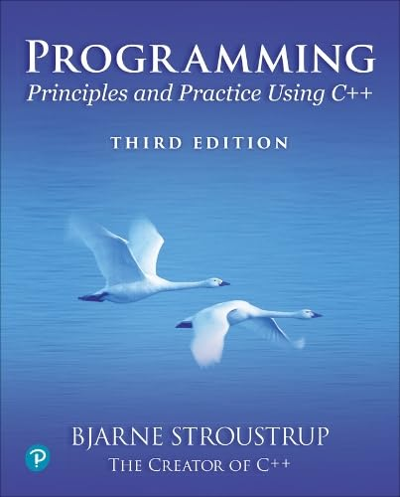
Chapter 20 – Maps and Sets
Write programs that do one thing
and do it well.
Write programs to work together.
– Doug McIlroy

Slide 2
TBD

